Slide 1
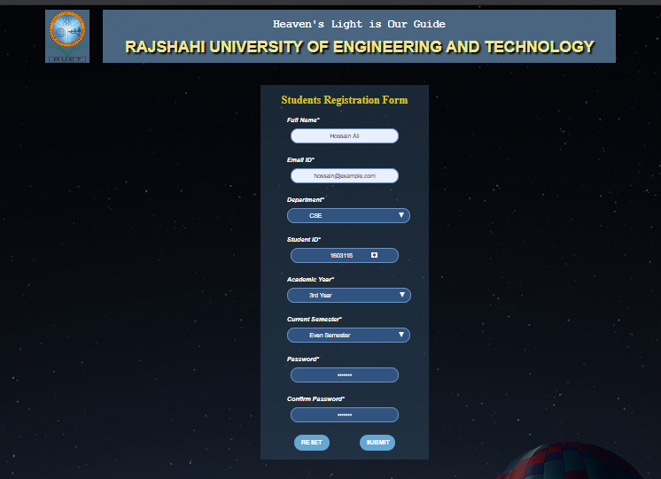
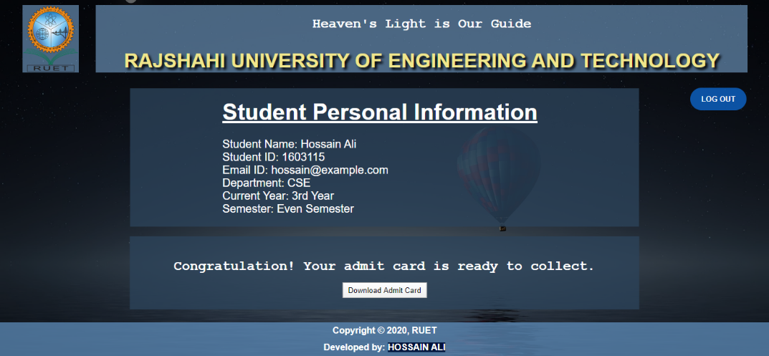
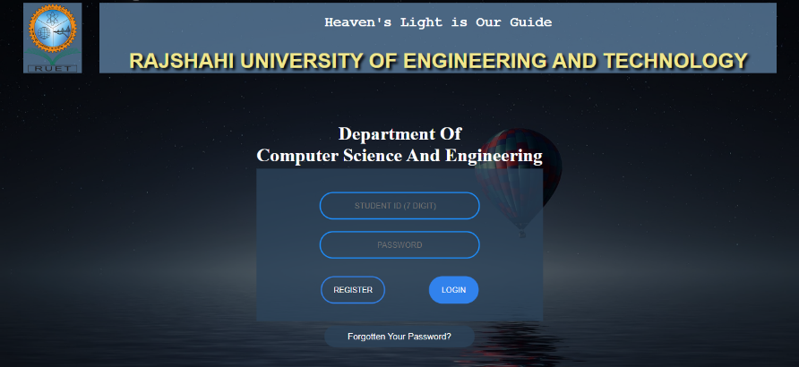
RUET Online Admit Card Download System
What is RUET online admit card download system?
An online website where all the semester final examination admit card will be available to collect easily from anywhere any time within the period of time.
Equipment needed for the project:
Operating System (Windows 10)
Microsoft Visual Studio Code
XAMPP as Hosting server
MySQL for using Database
Google Chrome Browser
PHP, HTML, CSS etc. as the programming
languages for Coding and designing stuff.
Features and Interface of the Website:
Students can Signup with their student ID
and other info and login with ID & password.
After login students can visit their personal profile page.
In their profile page they will gate a button to download their own admit card.
After the download they can logout the session and left the page.
Hossain Ali
1603115

